Slide 1



Overshoot,
Justice, and Multilateral Sovereign Guarantee Mechanisms
Official COP30
Side Event
20 November 2025
16:45 – 18:15
SIDE EVENT ROOM 5

Slide 2

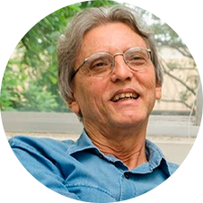
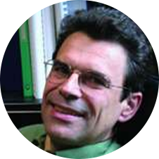
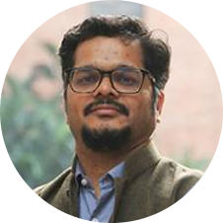
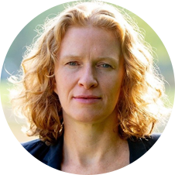
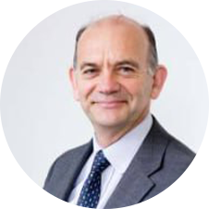
Panel 1: Multilateral sovereign guarantee mechanisms of climate finance
E. La Rovere
(COPPE/UFRJ, Brazil)
J.C. Hourcade
(CIRED, France)
M. Srivastava
(TERI, India)
H. C. De Coninck
(Eindhoven Univ.)
M. Grubb
(Univ. College London, UK)

Slide 3
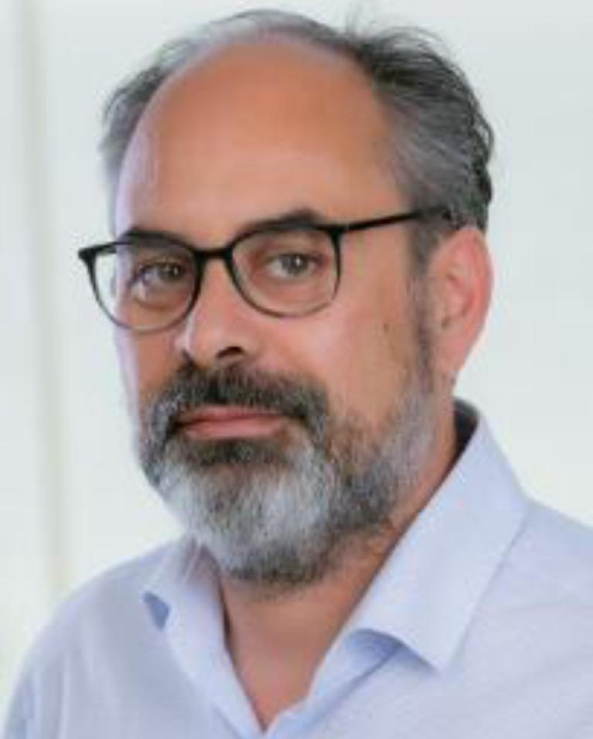
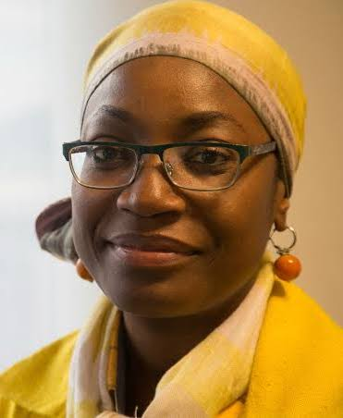
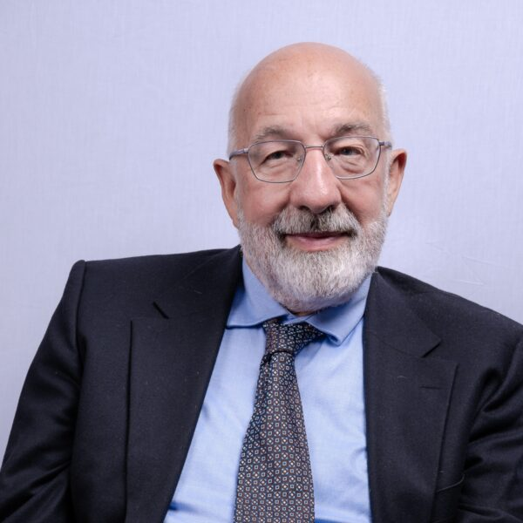

Panel 2: Advancing justice considerations in the context of mitigation and adaptation
KEYWAN RIAHI
IIASA, Austria
FATIMA DENTON
UNU-INRA, Ghana
BILL HARE
Climate Analytics, Germany
ANDREA SANTOS
COPPE/UFRJ, Brazil

